Slide 1
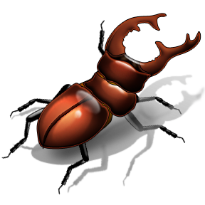
Using cover crops as part of organic IPM
Hooks
Lab
Cerruti R² Hooks
http://cerrutirrhookslab.umd.edu/

Slide 2
IPM
An effective environmental friendly approach to pest management that uses a combination of strategies to manage pest and their damage.

Slide 3
Organic IPM
An approach to managing pests that adds organically-approved tools in a way that limits economic, health, and environmental risks (UVM).

Slide 4




Strategies that can contribute to a organic IPM program
Distant
Row spacing
Pesticides
Sanitation - destroy after harvest, plow under
row covers
BC agents
Tillage (strip, no-till, etc)
Irrigation
Plant diversification
Notes:
didn’t focus on a combination of strategies but decided to go with one.

Slide 5
Trap cropping
Genetic diversification (breeding)
Inter-cropping
Mixed planting
Flowering borders
Barrier crops
Cover cropping

Slide 6
Why cover crops
Organic IPM

Slide 7
I double crop
I wanna
destroy weeds
Better insect management
Better fertility & soil quality
Healthy plants

Slide 8
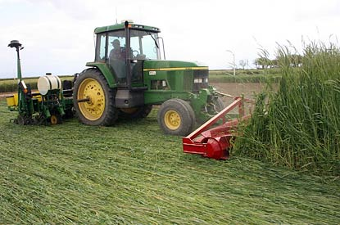
Cover crops manipulation
Suppression
  Chemical suppression
  Mechanical suppression
  Cultivation
  Natural suppression
Cover cropping strategy
  Green
  Straw or hay mulch
  Dying mulch
  Living mulch

Slide 9
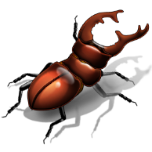
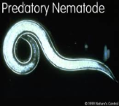
Target multiple pest complexes simultaneously
insects
weeds
nema-todes

Slide 10
Few field examples

Slide 11
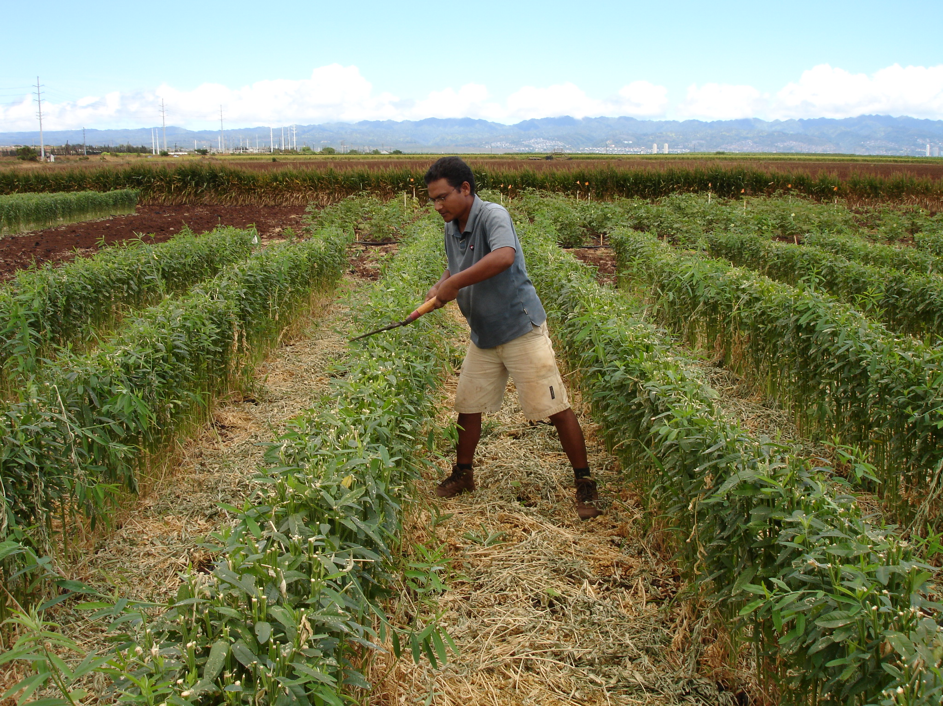
sunn hemp

Slide 12
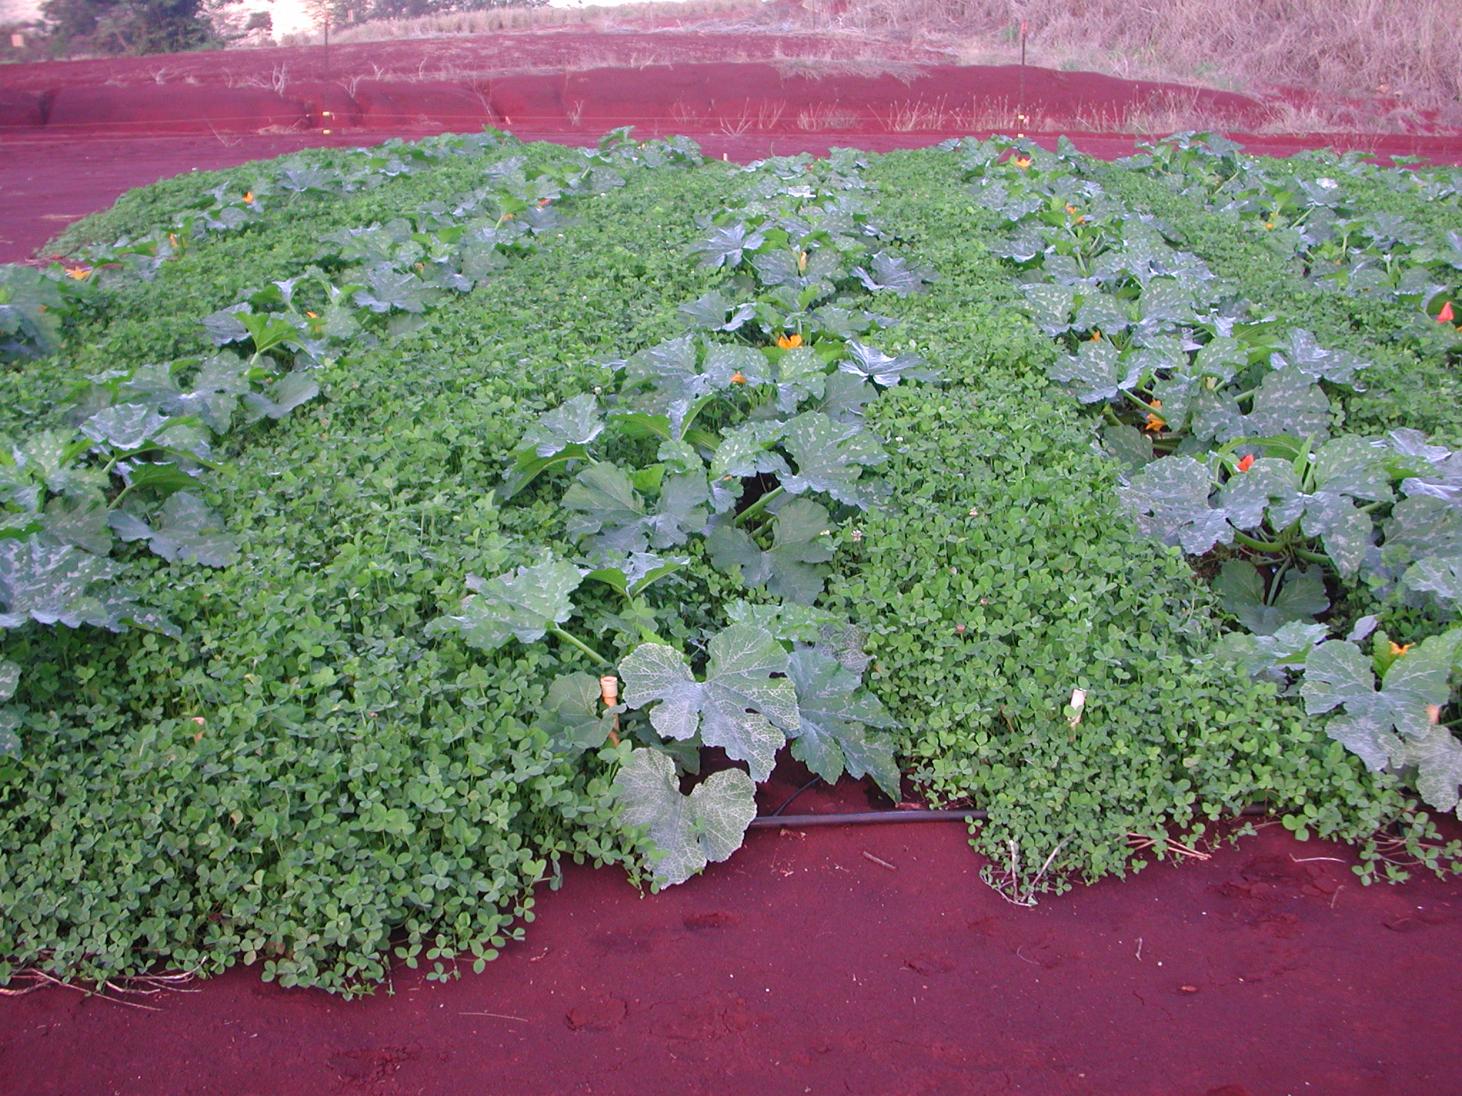
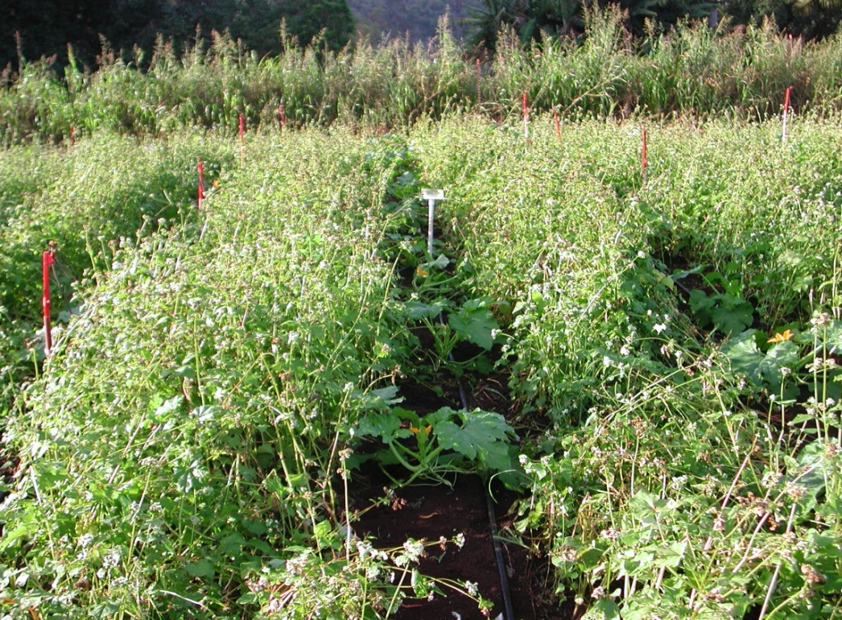
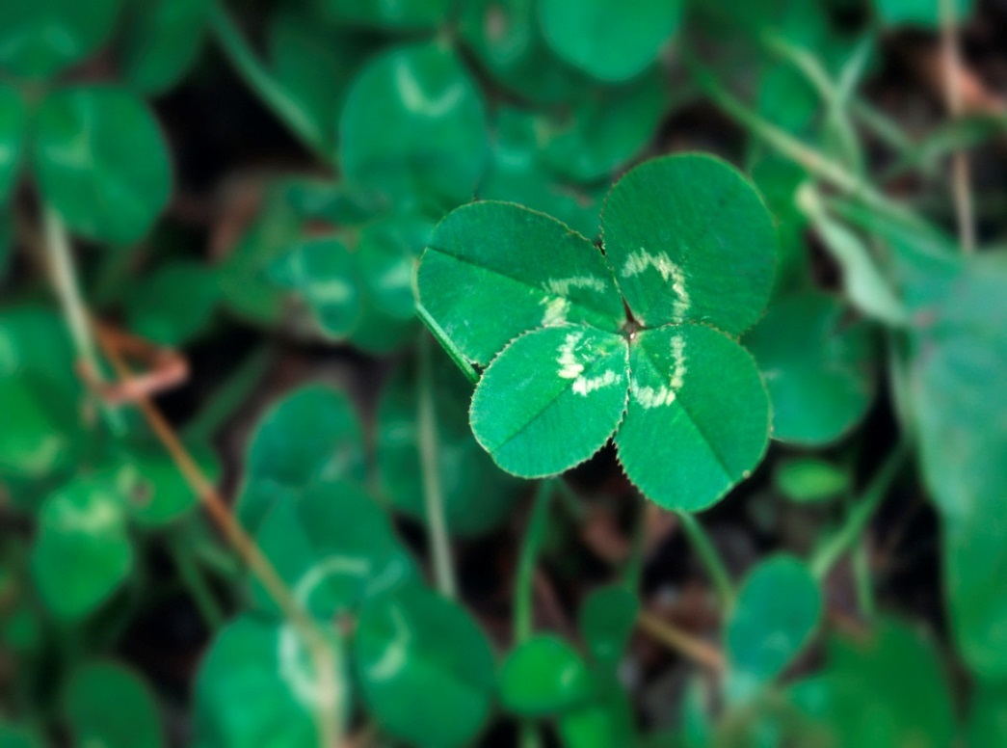
additional companion plants

Slide 13
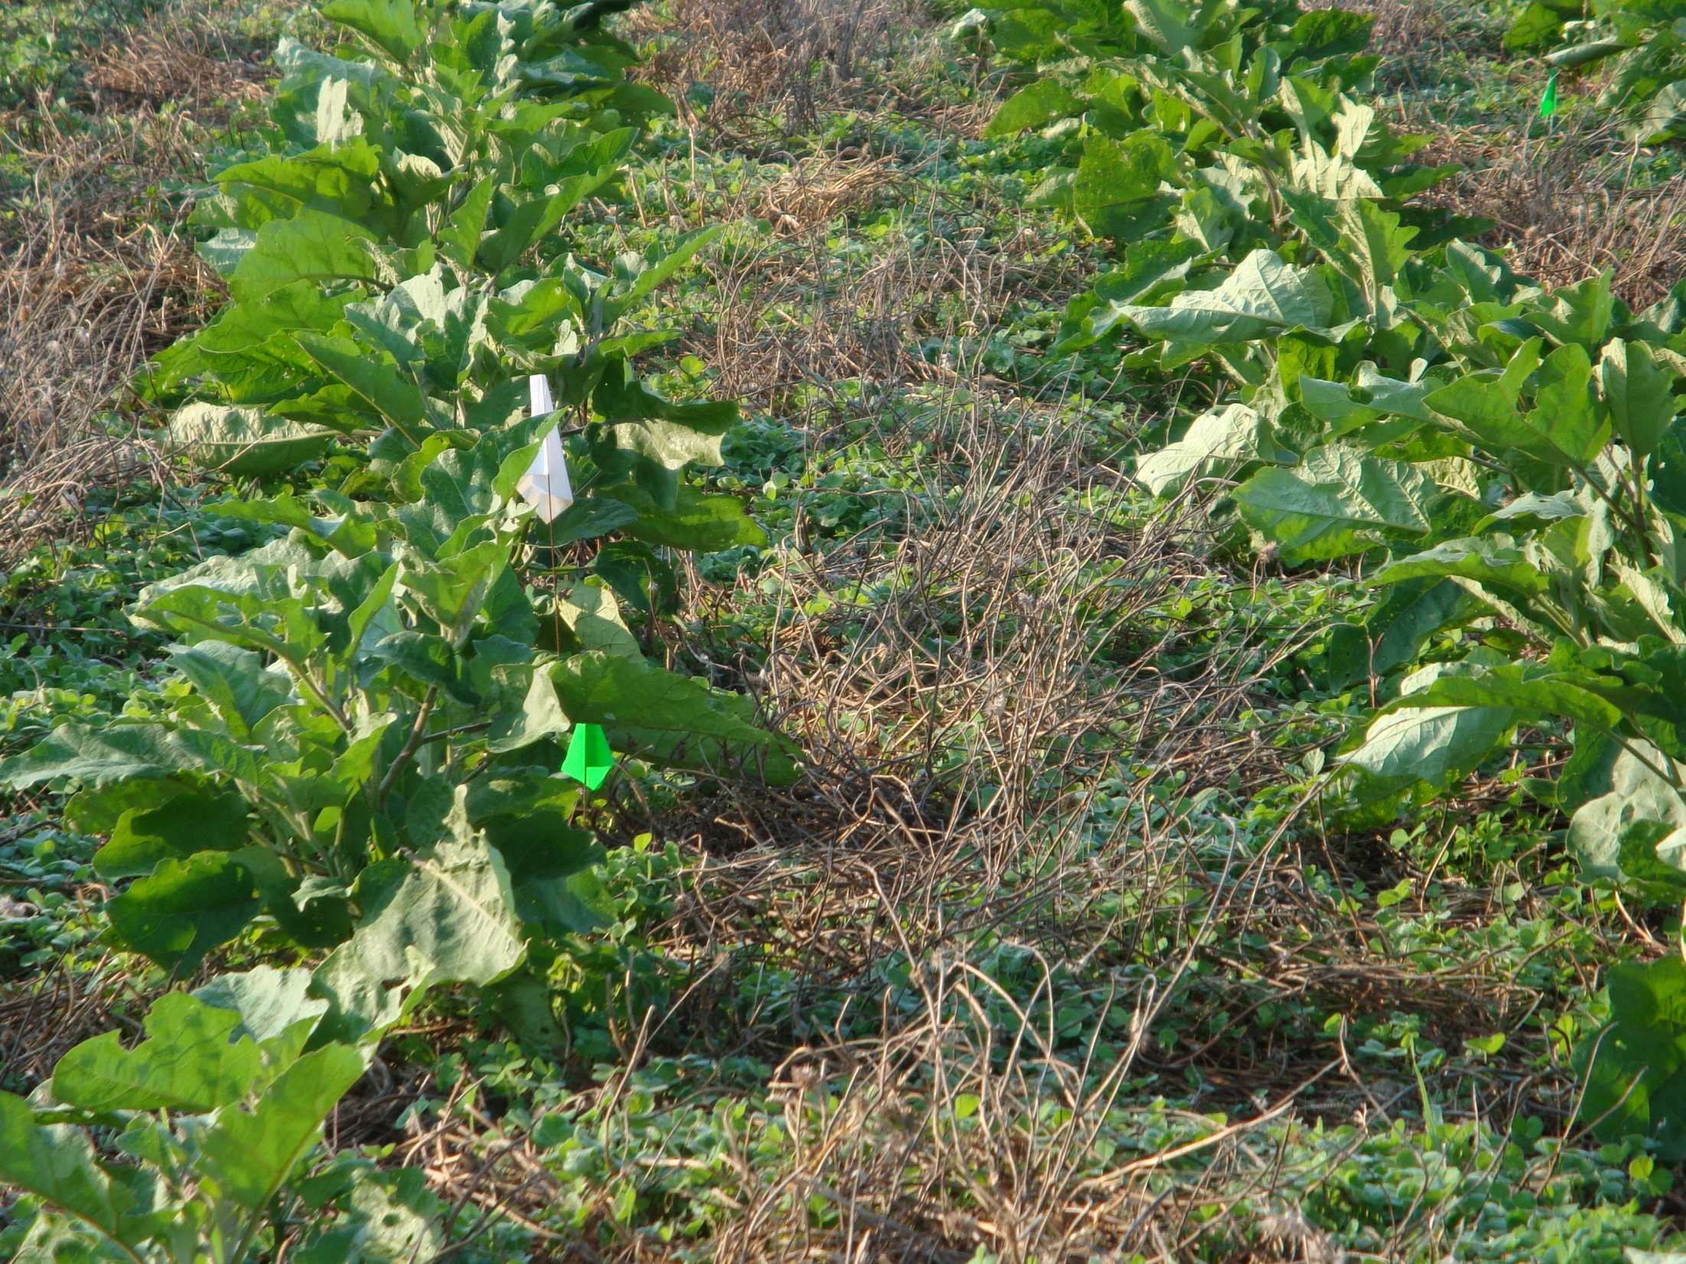
OMRI
Dying mulch

Slide 14
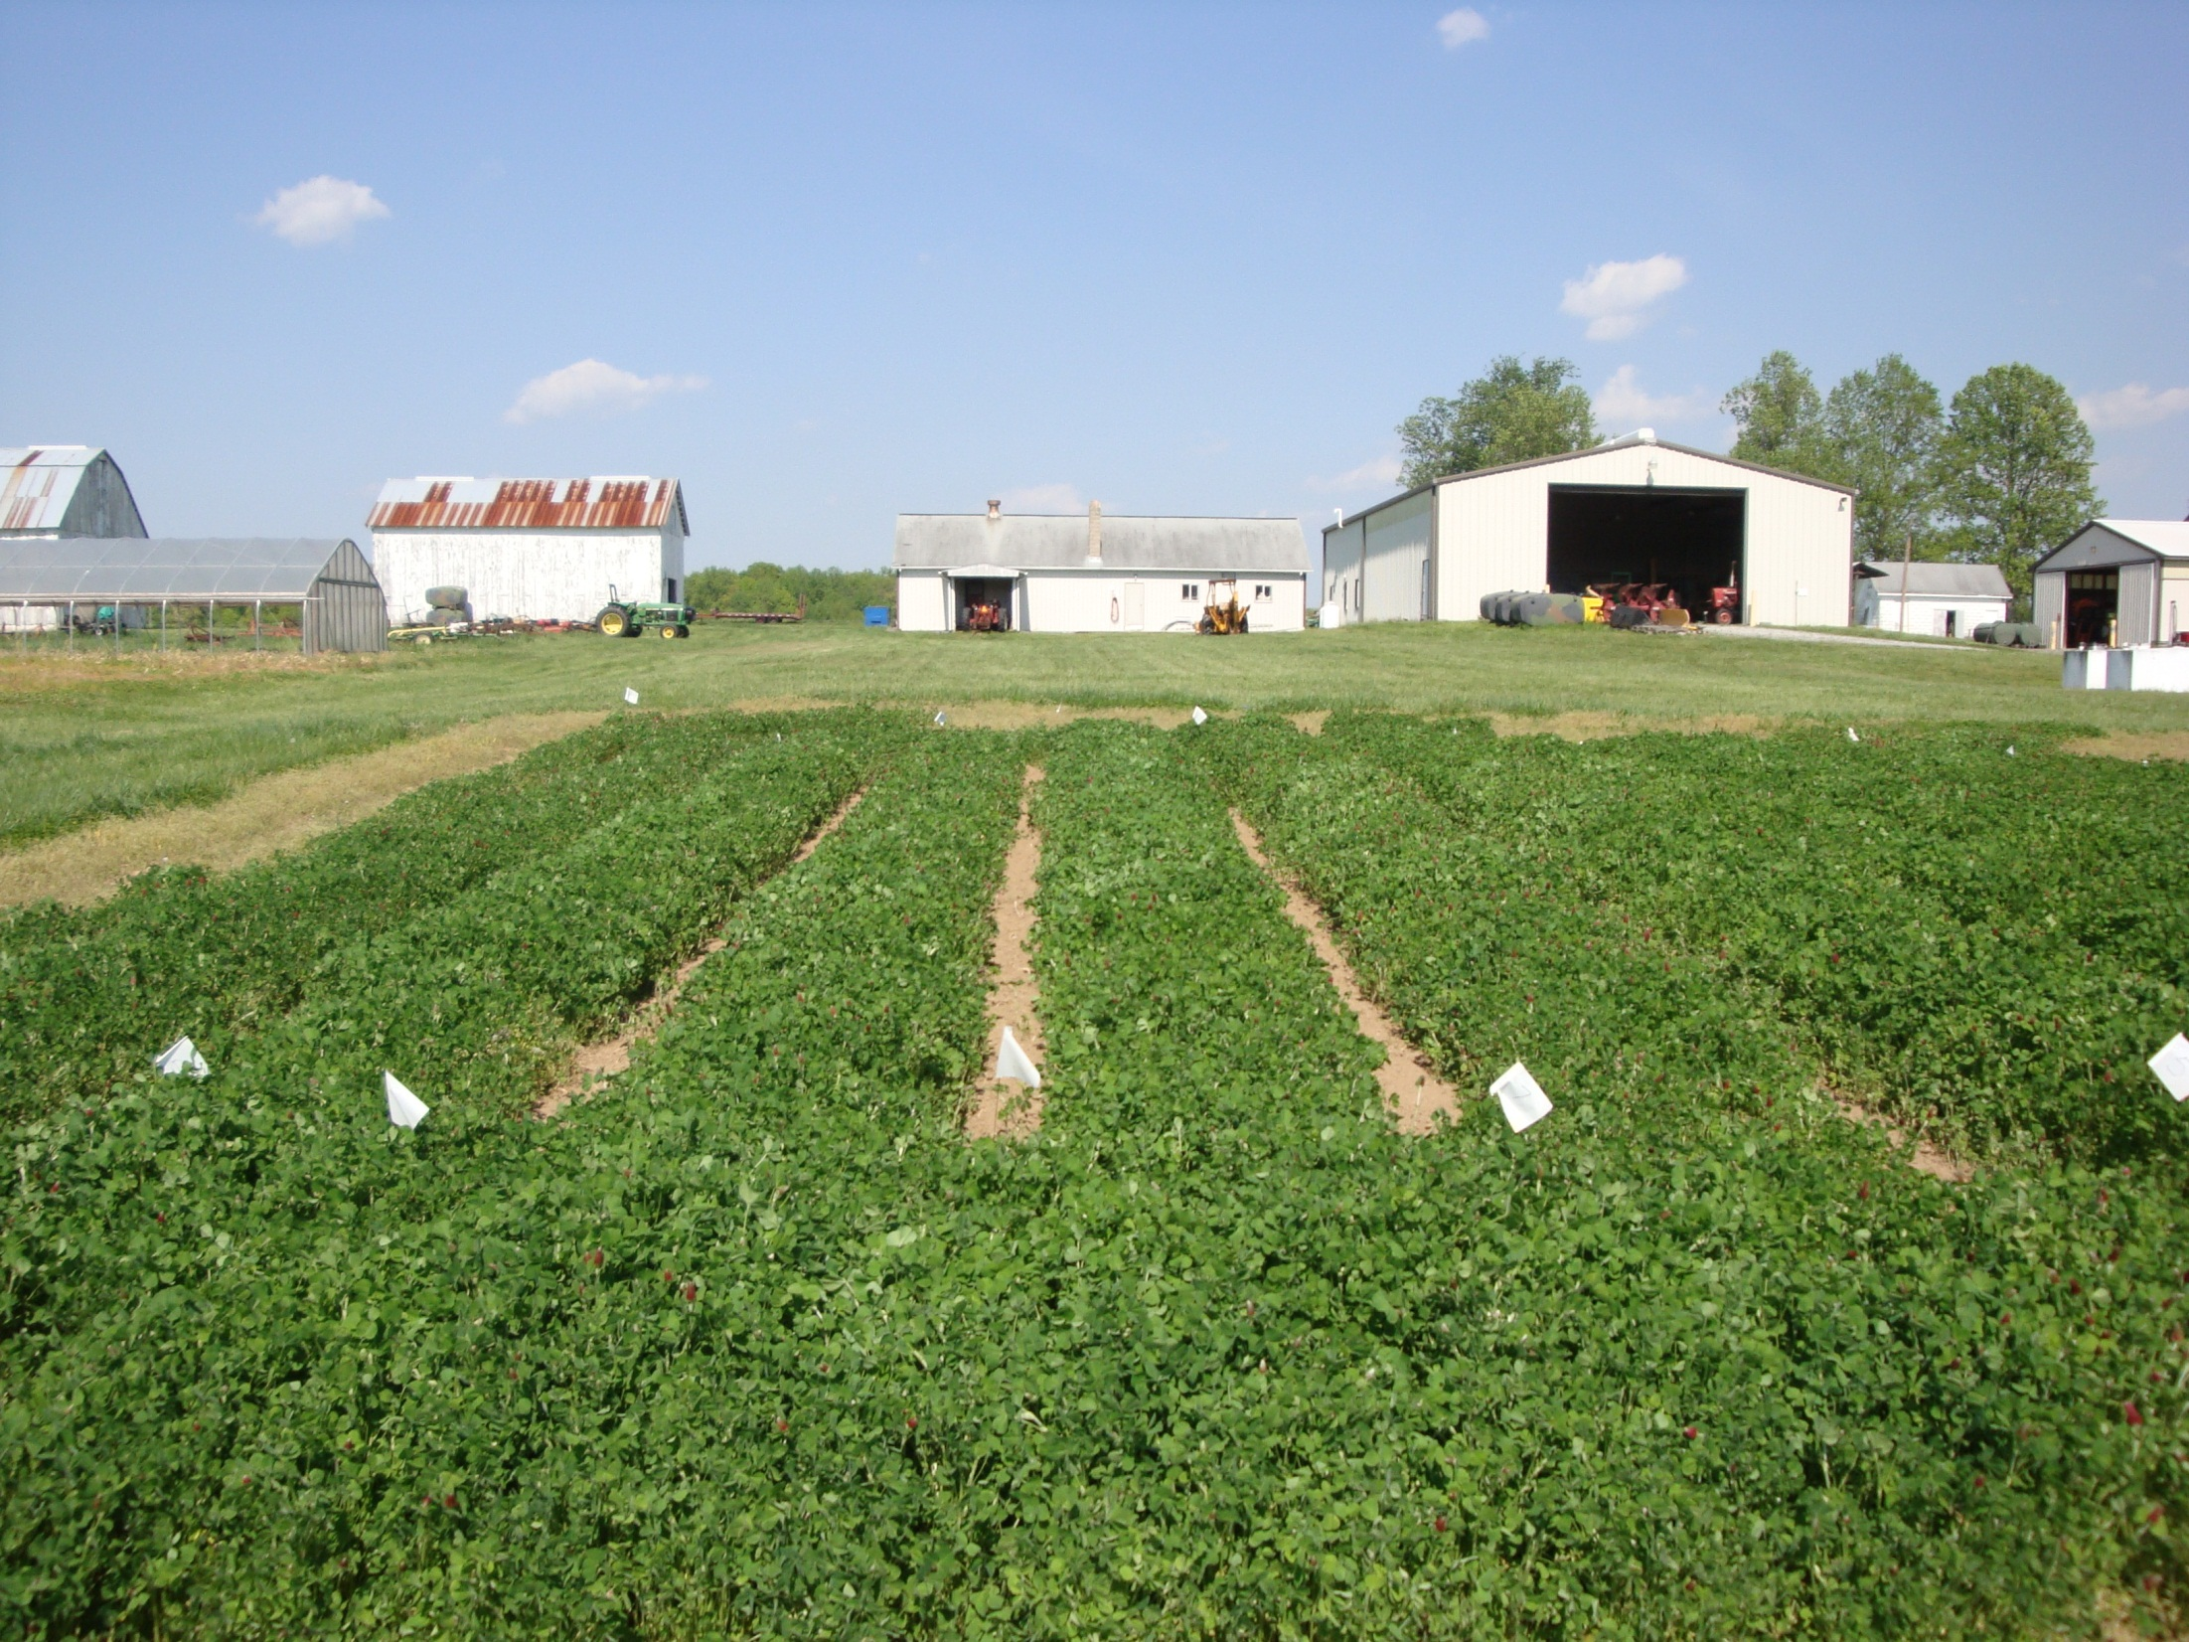

Slide 15
Organic IPM can be a useful tool in conventional system but more research is needed to determine the economical and environmental cost of adoption.

Slide 16
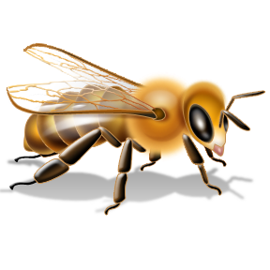
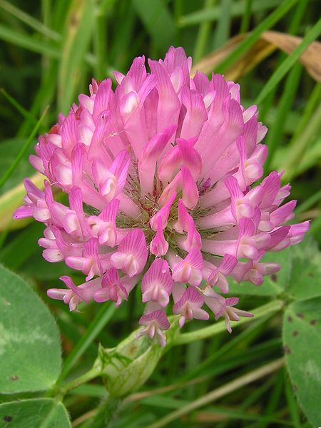
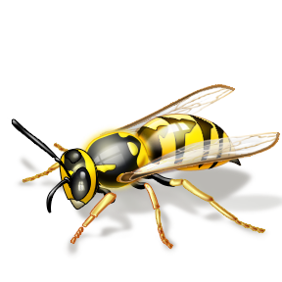
Cover crop for organic IPM + Pollinator programs

Slide 17
Acknowledgements
USDA NIFA
OREI
ORG
SCRI
NERIPM
ARDP
EIPM
WRIPM
TSTAR
MAES
Delmarva Land Grant
UH & UMD Research & Edu. Facilities Oahu, Upper Marlboro, Wye and Keedysville
Various lab members and interns - past and presence
Vegetable
Growers
Association

Slide 18
The End

